Slide 1
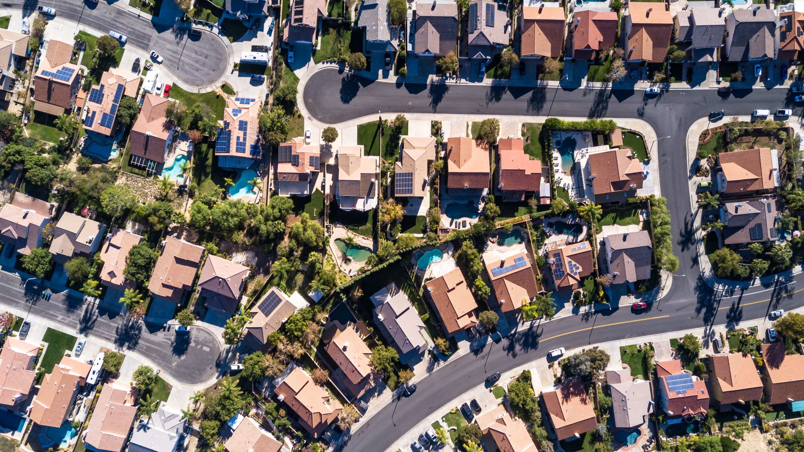
Melbourne Housing Market
By: Furqan Akhtar

Slide 2

Project Brief
Melbourne’s housing market has finally cooled off.
Provide a general overview of market.
Where's the expensive and in-expensive side of town?
Which area to look for to buy a 2-bedroom unit within city centre with a budget of 0.8$ million?
Additionally, could you find a trend or give a prediction?

Slide 3
Contents
Exploratory Data Analysis
Data Cleaning
Market Analysis
Machine Learning Analysis
Conclusion

Slide 4

Exploratory Data Analysis

Slide 5
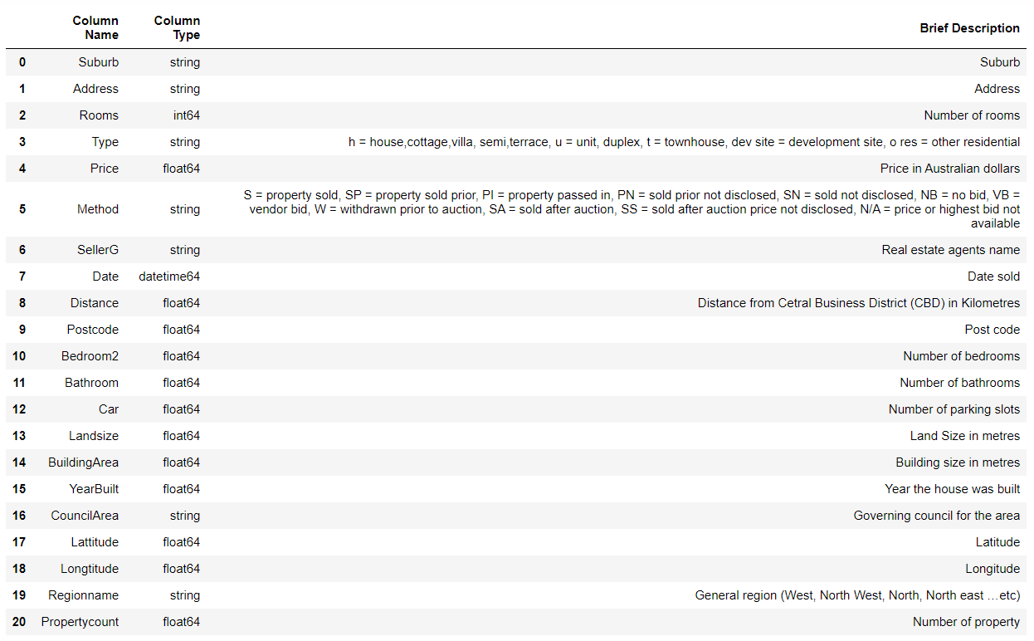
Data Dictionary

Slide 6
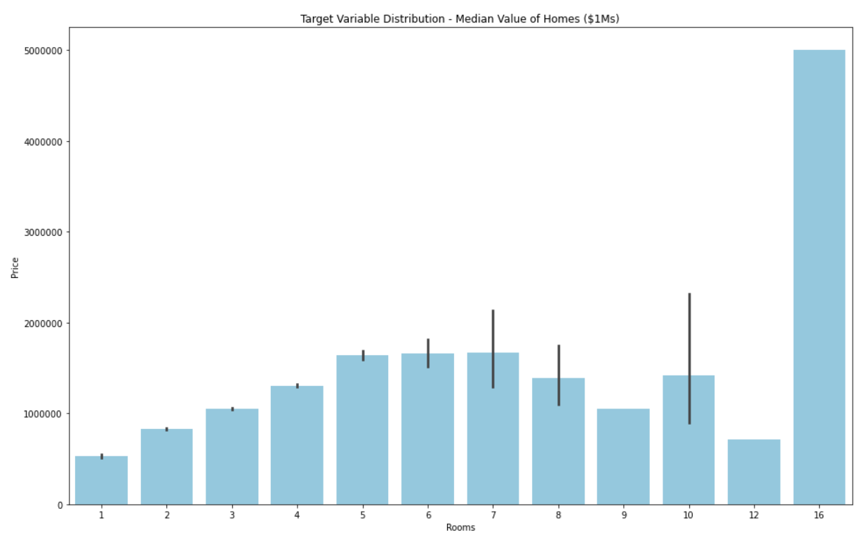
Average Price Against Number of Bedrooms

Slide 7
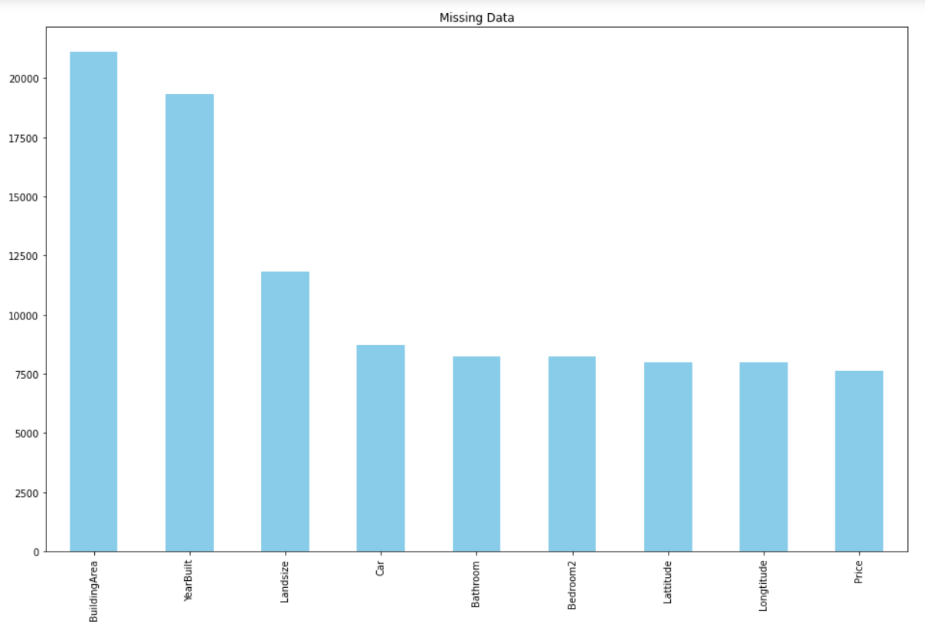
Sum of Null Values

Slide 8

Data Cleaning

Slide 9
Missing values
Removed columns with more than 10k null values
Removed a duplicate column
Removed a column irrelevant to analysis

Slide 10
Replaced coded values
Dropped rows of data where price was not disclosed
Replaced null values with mean where applicable
Coded Values

Slide 11
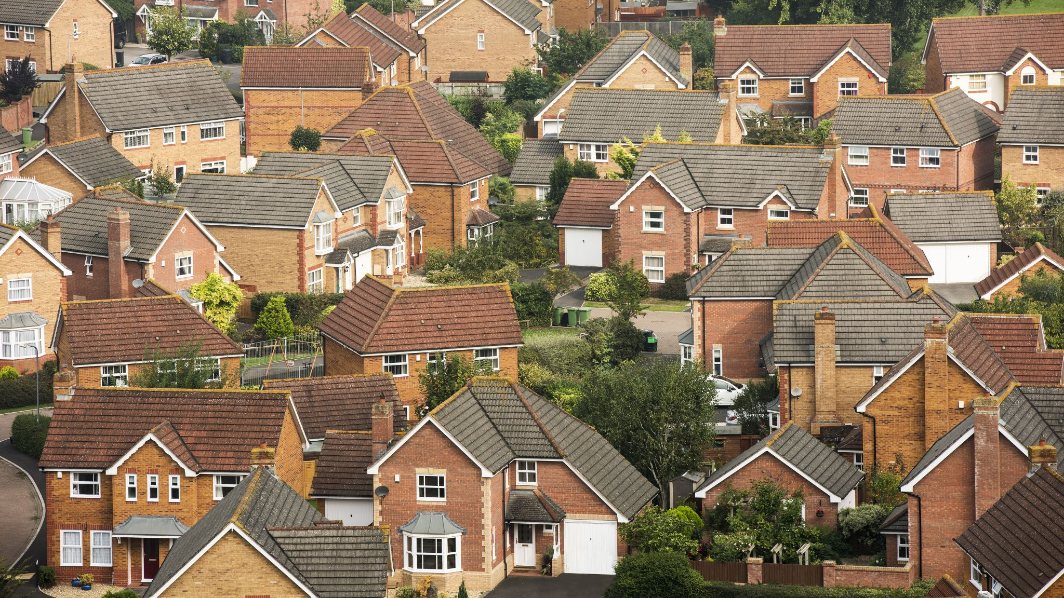
Market Overview

Slide 12

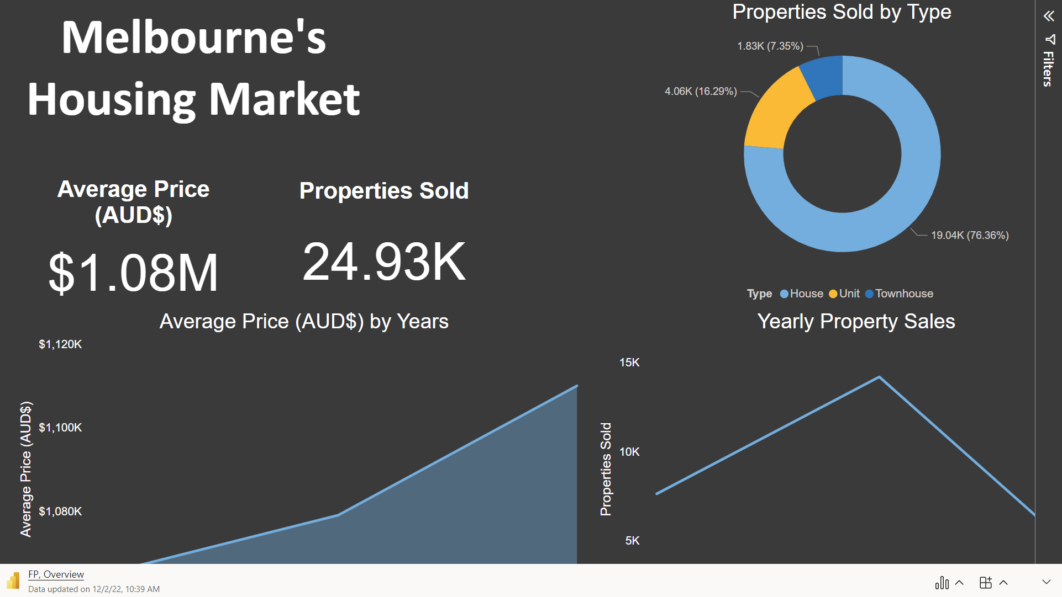

Slide 13
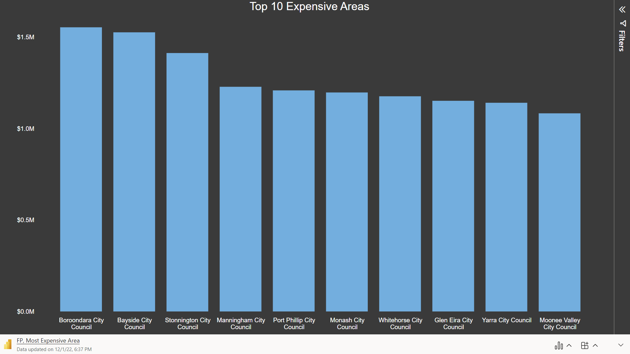

Slide 14
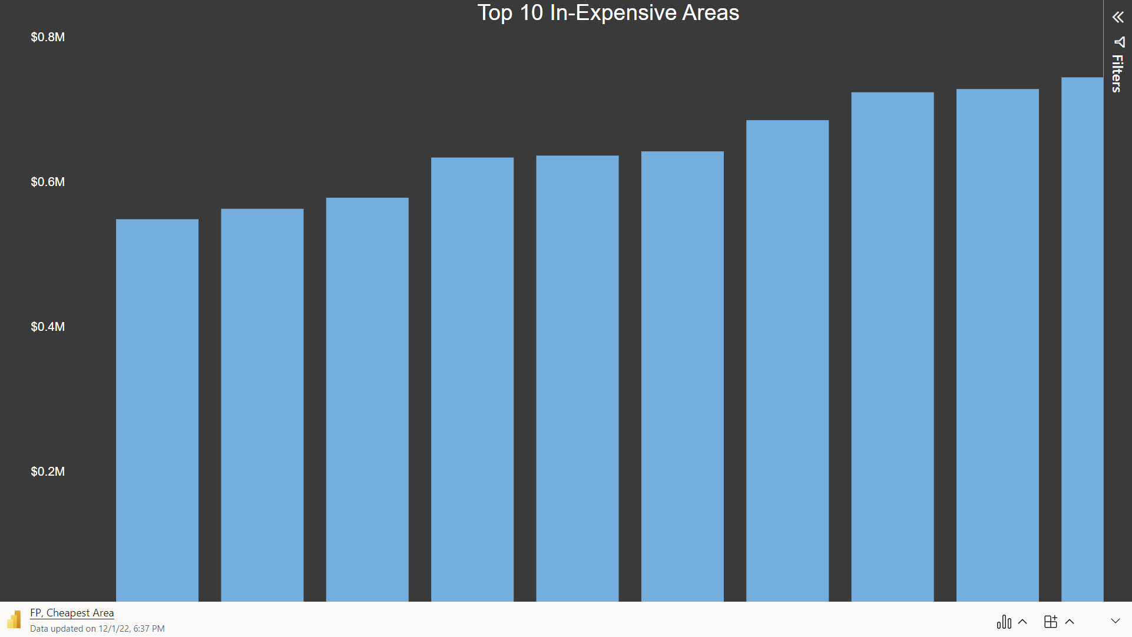

Slide 15
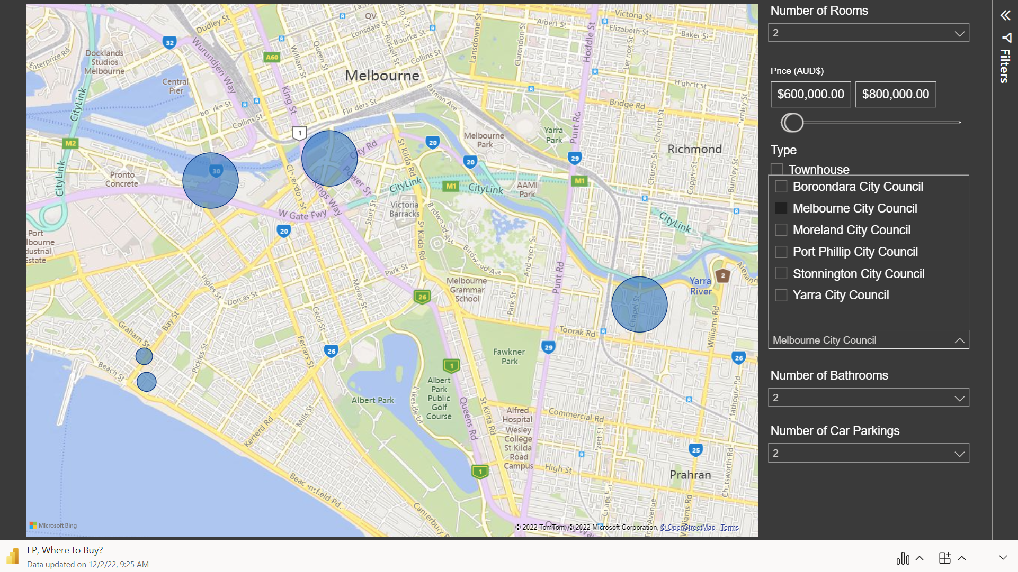

Slide 16

Machine Learning

Slide 17
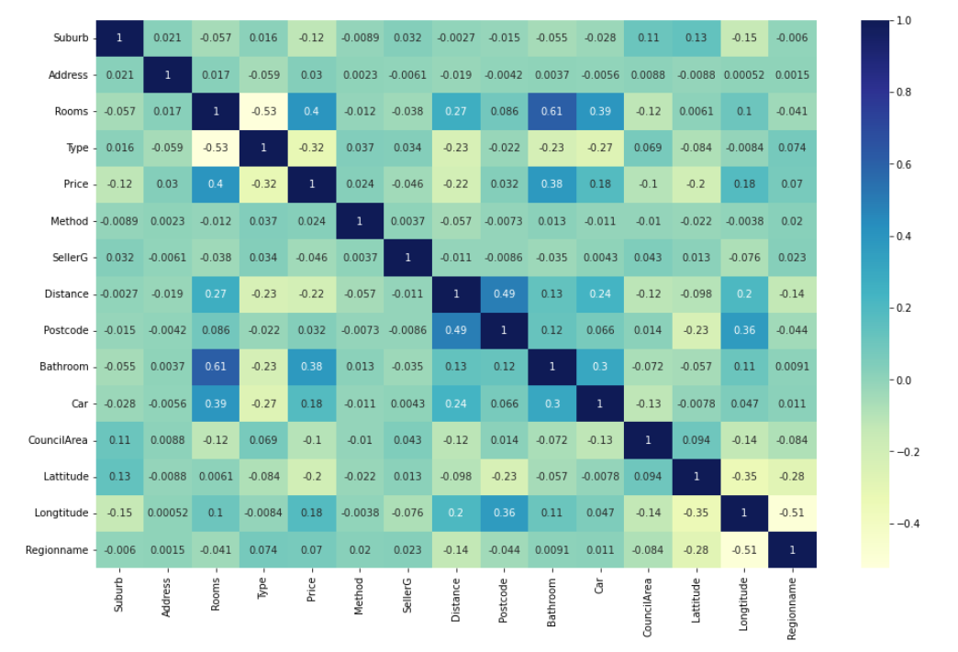
Heatmap

Slide 18
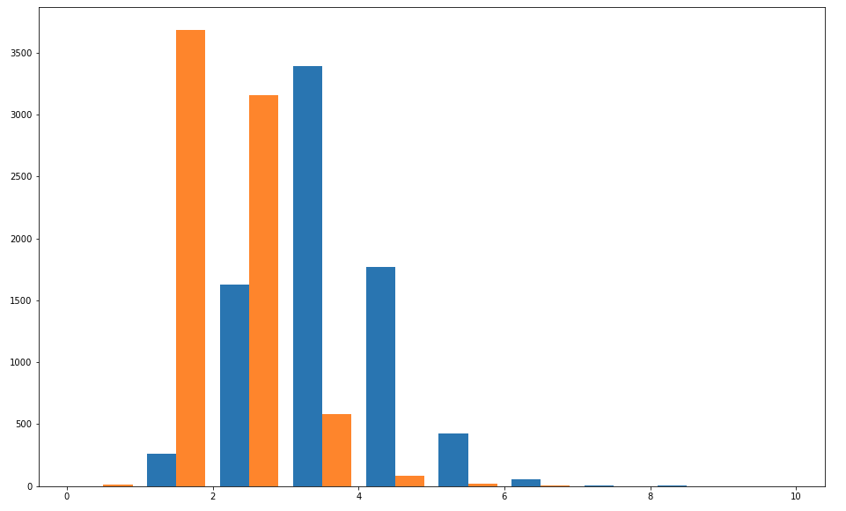
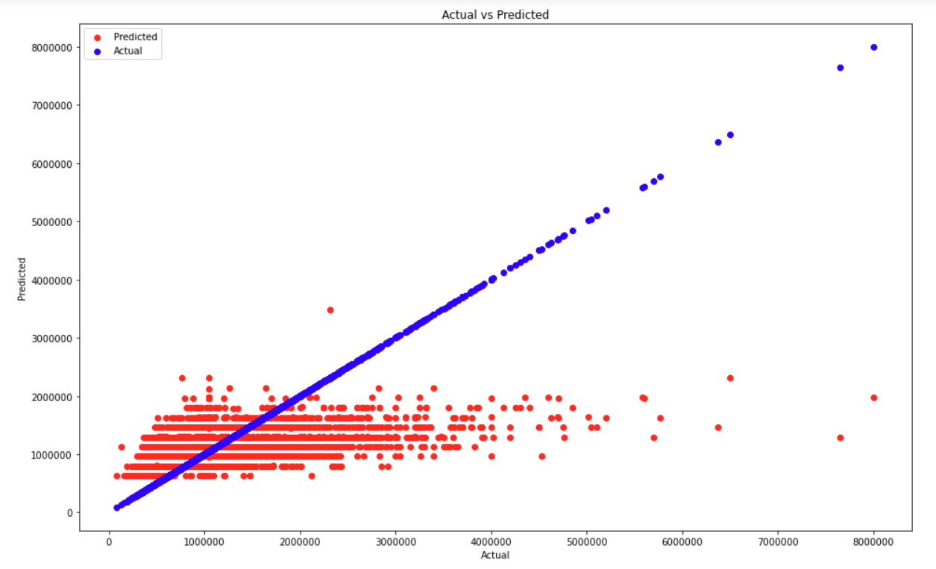
Test 1
R2 score: 18.98%

Slide 19
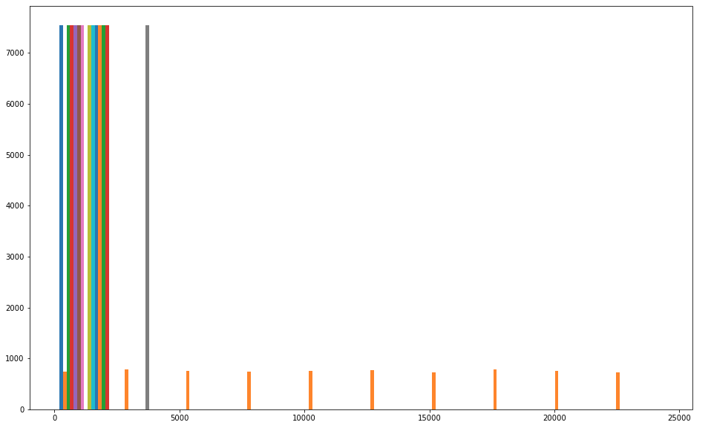
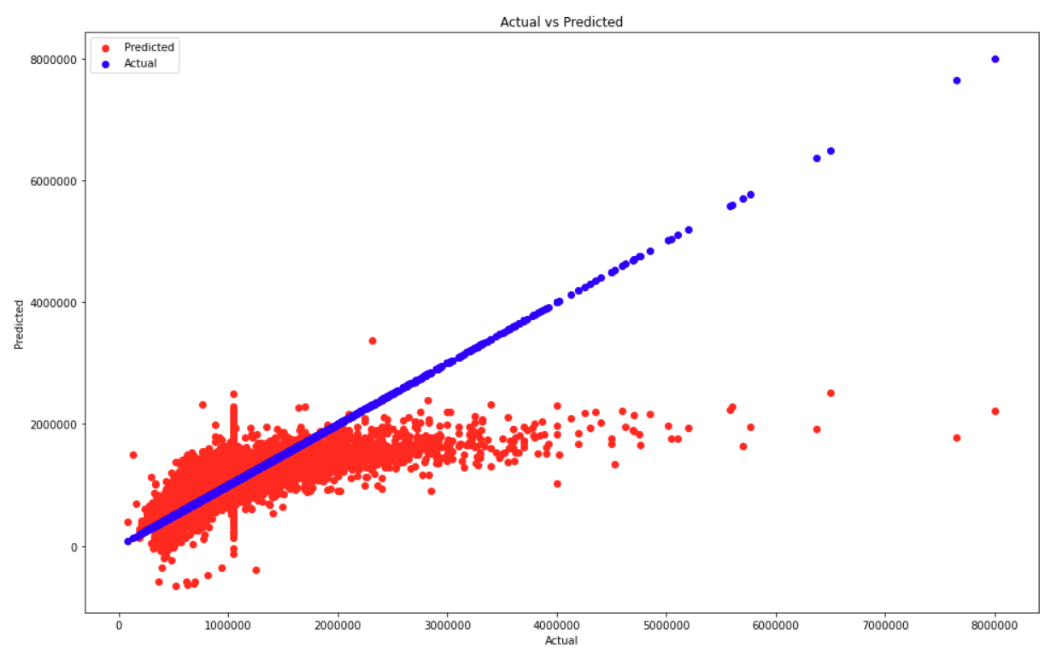
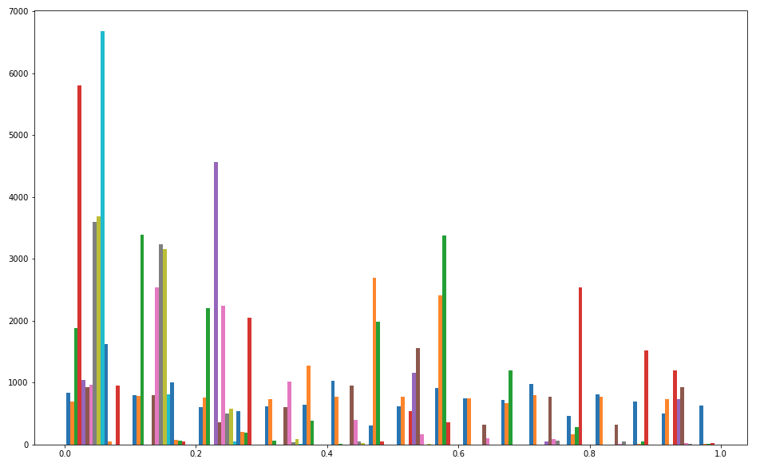
Test 2
R2 score: 42.86%

Slide 20
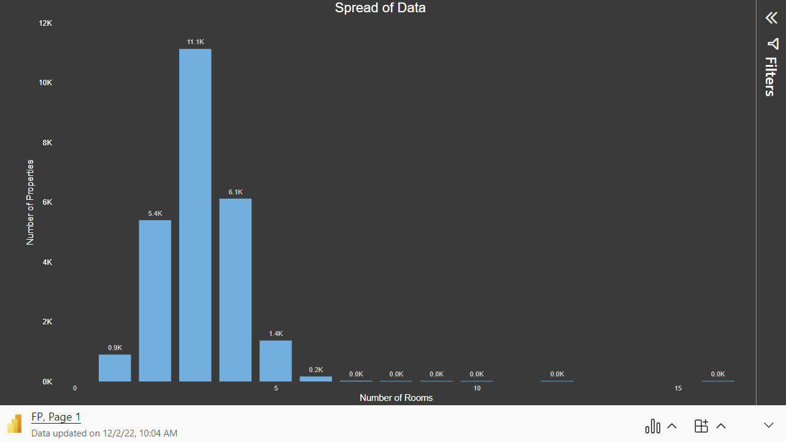

Slide 21
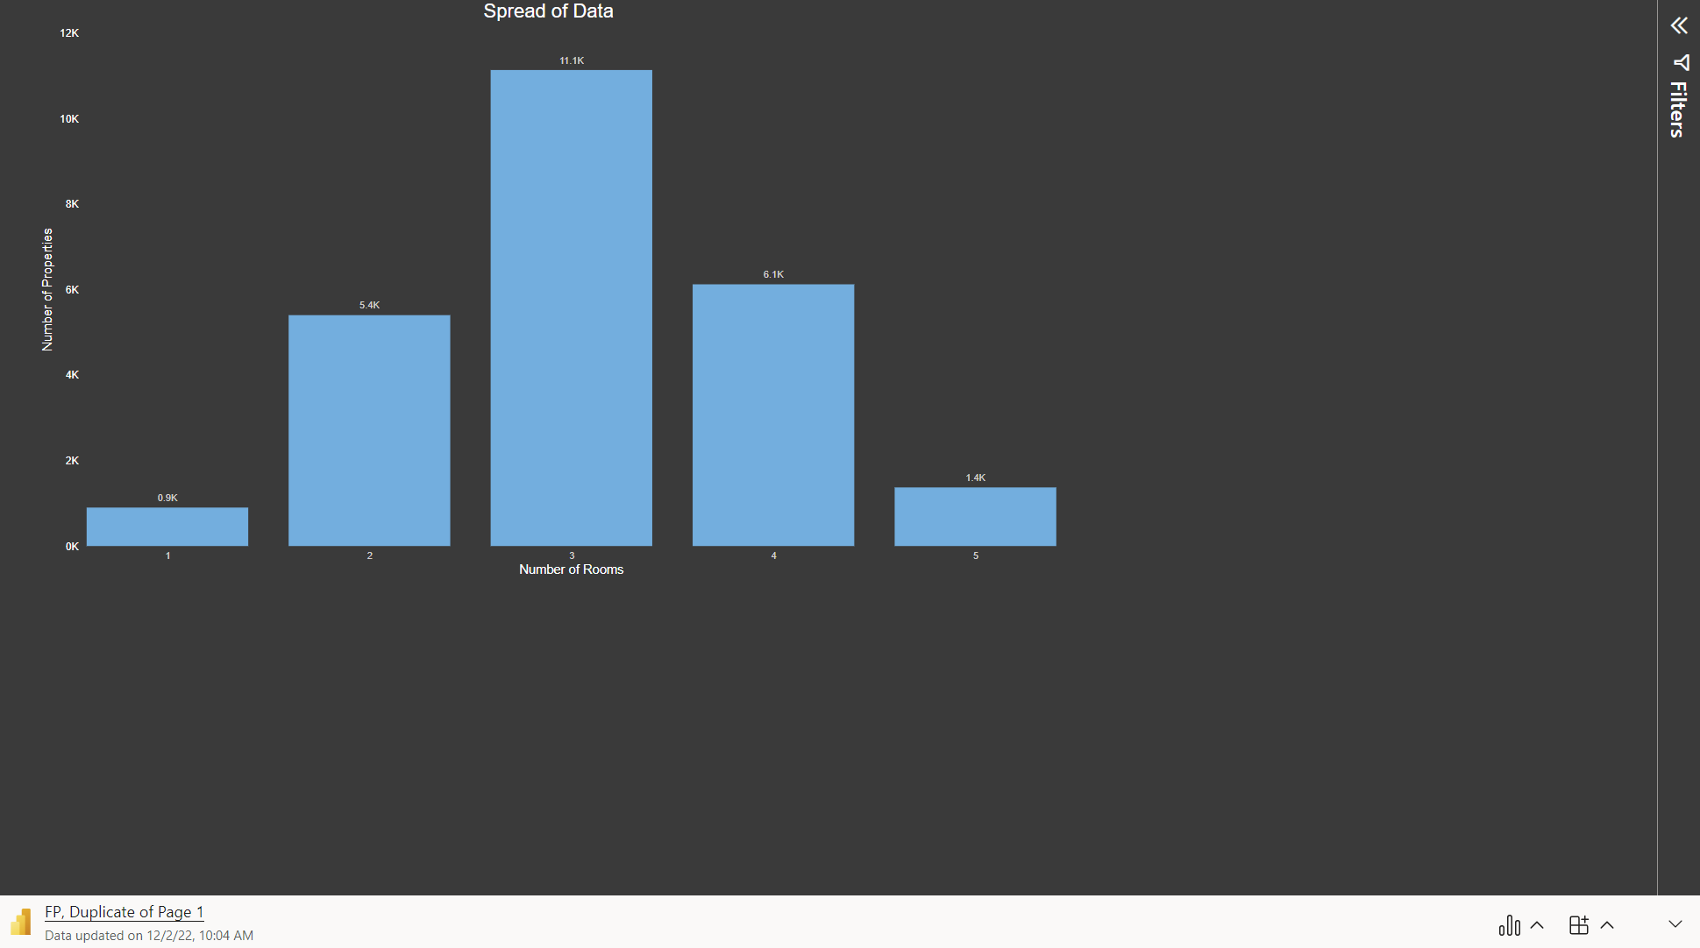

Slide 22
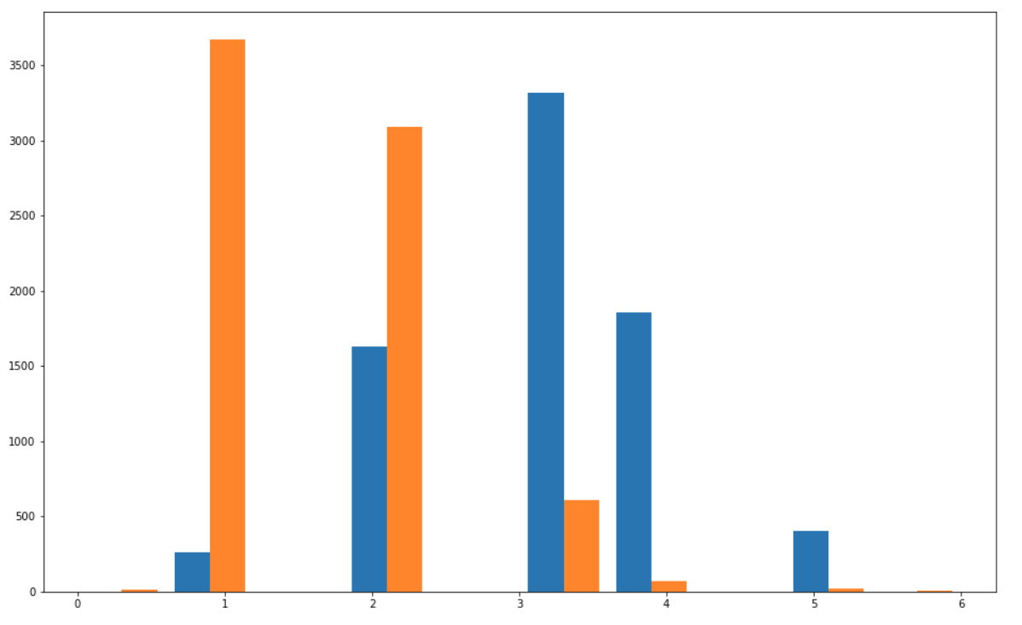
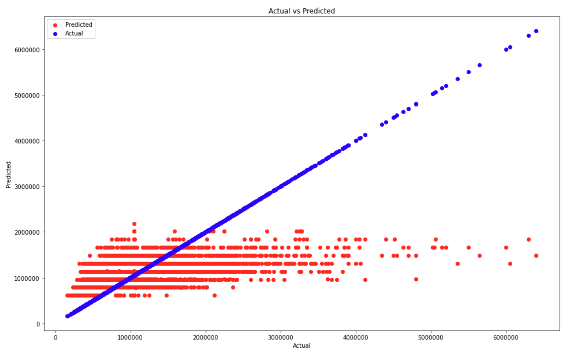
Test 3
R2 score: 19.71%

Slide 23
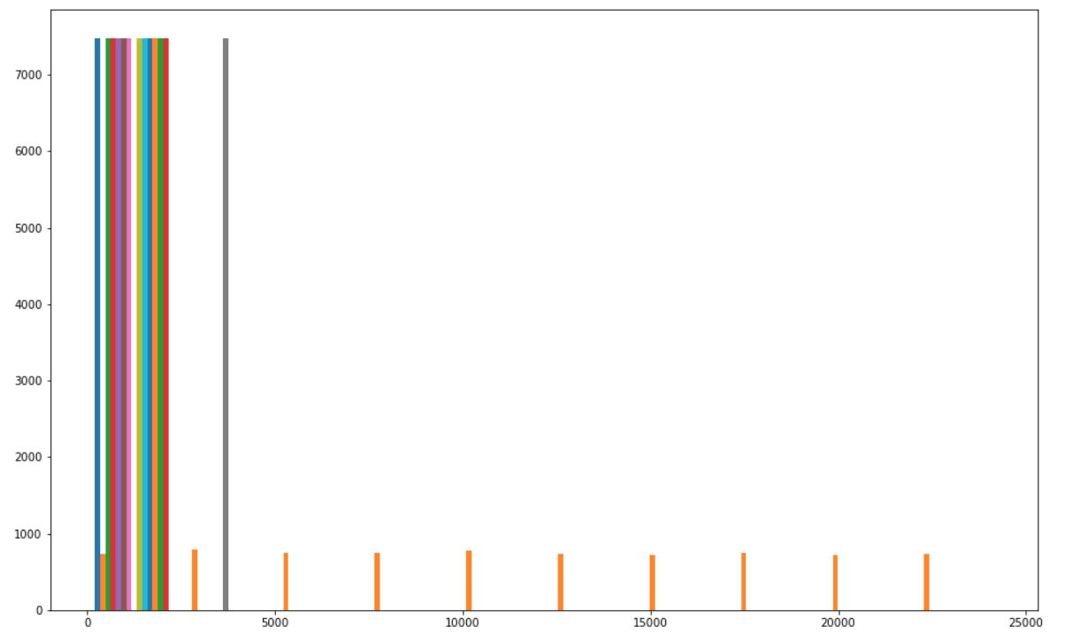
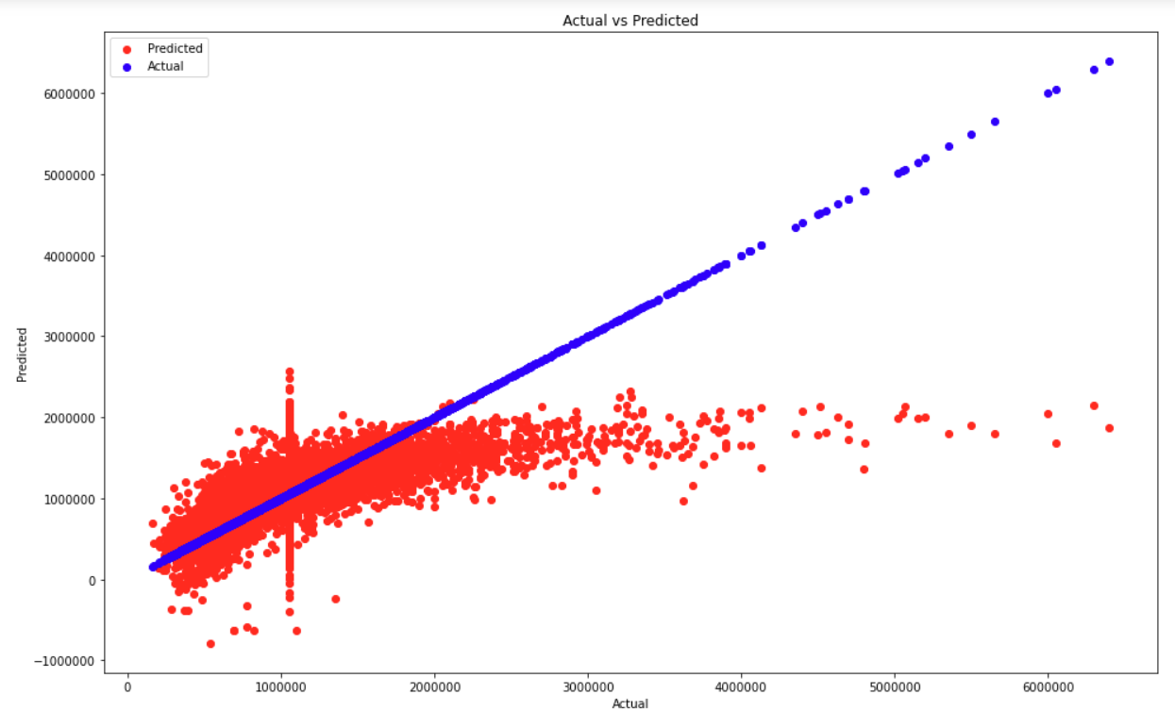
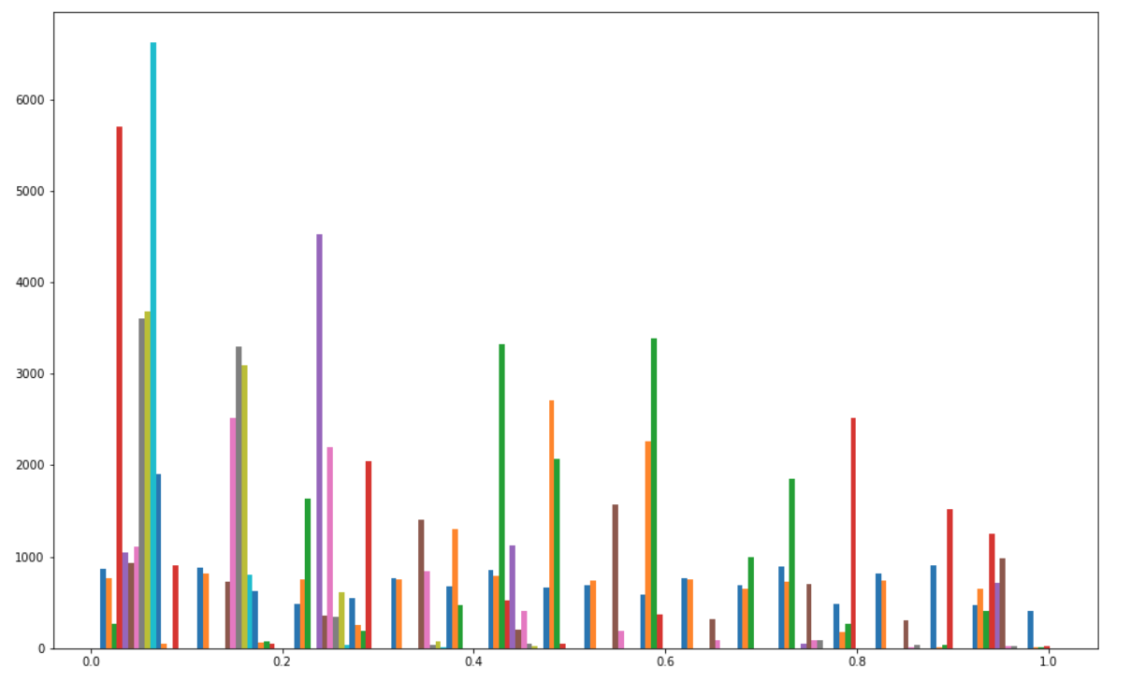
Test 4
R2 score: 43.83%

Slide 24
Comparison
Including all bedrooms
Number of iterations | R² Score
1st (Only 2 columns) | 18.98%
2nd (All columns) | 42.86%
Removed houses with more than 5 bedrooms
Number of iterations | R² Score
3rd (Only 2 columns ) | 19.71%
4th (All columns) | 43.83%

Slide 25
Conclusion
Provided an overview of Melbourne’s real estate market
Most expensive area of the city: Boroondara City Council
Cheapest area of the city: Moorabool Shire Council
Where should they buy a 2-bedroom unit?
Melbourne City Council
Moreland City Council

Slide 26
Further work
ARIMA Model
Lasso & Ridge regression
Analyse with up to date data

Slide 27
Thank you for Listening
Any Questions

